Slide 1
User Experience of Google Maps ios version
Lisha Han

Slide 2
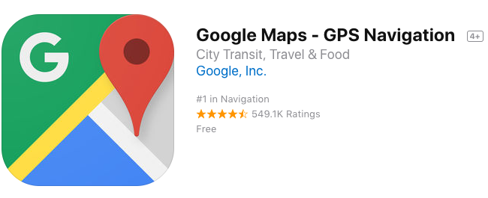
Amazing App
Google maps app is amazing. There are too many pros of it. I will only list the functions that I use frequently.

Slide 3
Pros
Design of this app is concise. Easy to use. User can find the function they need without complex procedure.
I took trains to commute to school. As a daily commuter the real time train/bus information is very useful.
Offline maps is very useful when I have bad network connection.
It will provide useful information like website, comments, visit rate by hour, phone number, opening hours, pictures and street view of the place I search in the app.

Slide 4
Cons
Google maps loses its accuracy in city with complicated planning such as Boston. The complex highway design makes google maps get confused frequently. It has no idea which route I am on and will reroute while I have to merge 3 lanes to exit in 300ft. Eg. The ramp from Chinatown to i93 south.
It doesn’t give signal in time when encountering forks. First I came to Boston it took longer than expected to reach my destination. I often choose the wrong side of forks. This happens in other cities too.

Slide 5
Cons
Option column will appear during navigating. It will cover half of the screen. It often happens during driving. This function is not very safe.
The multi-destination function is not well designed.
When rerouting it will lead me to toll highway automatically.
No real time construction or detour information.

Slide 6
Improvement
Improve accuracy of routes have parts overlap.
Put the option button in somewhere else that not easy to be touched during driving.

Slide 7
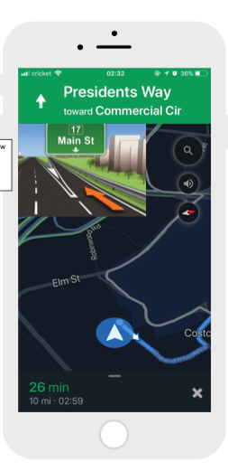
Improvement
Give details of forks in advance. Show fork details in bigger picture above the map.

Slide 8
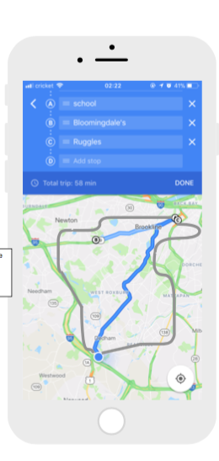
Improvement
Optimize multi-destination function. Give better route suggestions other than just giving only one option and just go from one point to another.

Slide 9
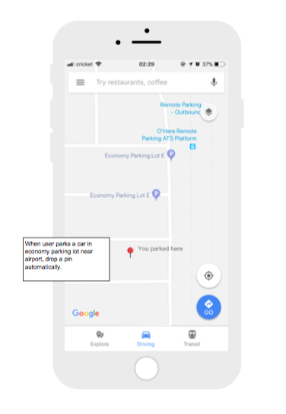
Think a little bigger
When we leave for a while we may park our car in an economy parking lot, it is easy to forget where we parked. Add function that it can drop a pin for user automatically when they parked in an economy parking lot around airport.

Slide 10
Think a little bigger
If user authorize to share data with google maps let the app study user habits and give users better advices. For instance, when rerouting during driving, the map could navigate me to the route I use frequently. Or the map could reroute me to my preference as avoid toll highway. Then I don’t have to pull my car over and choose a local route.

Slide 11
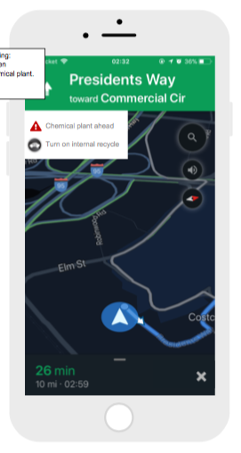
Think a little bigger
There will be bad chemical smell coming out from my air conditioner every time I drive past a place close to chemical plant. And I forgot to turn on internal recycle every time. There could be a function that the map can give me warning or hint 2-5 mins in advance before I pass chemical plant area. Or google map could connect to my car. When I drive to the place I turn internal recycle on frequently, this app can turn on internal recycle automatically(sync with my habits).

